Slide 1
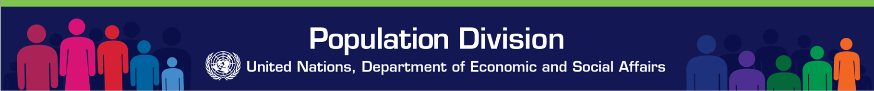
Migration, mobility and big data: An overview
GMG International Conference: Harnessing Migration, Remittances and Diaspora Contributions For Financing Sustainable Development
Session 3: Delivering the post-2015 agenda: The big data revolution on migration
United Nations
New York, 26-27 May 2015
Patrick Gerland

Slide 2
Overview
Definition and concepts: what do we mean by international migration and mobility
Major topics/issues of interest from a global and local perspective
What kind of big data
Examples how big data have been used
Notes:
2

Slide 3
Definition: international migration
Essentially, a migrant is a person who changes his/her place of residence
An international migrant is defined as any person who changes his or her country of usual residence
A long-term international migrant is someone who changes the country of residence for 1 year or longer
Short-term: between 3 and 12 months
(< 3 months: visitor)
United Nations (1998). Recommendations on Statistics of International Migration, Revision 1 http://unstats.un.org/unsd/publication/SeriesM/seriesm_58rev1e.pdf

Slide 4
Concept: international migration
Three key concepts related to measuring international migration and counting migrant stocks:
country of birth
country of citizenship
country of residence 1 or 5 years ago (or: year of arrival)
United Nations (2014). Draft Principles and Recommendations for Population and Housing Censuses, 2020 round (Revision 3) http://unstats.un.org/unsd/demographic/meetings/egm/NewYork/2014/P&R_Revision3.pdf
Question: can 'big data' assist us in (better) measuring international migrant stocks or international migration flows?

Slide 5
Definition: spatial mobility
Short-term internal or international movements of people for almost any purposes
Variable duration: within a day or several years
Variable distance: local, domestic or international
Variable purpose: including daily commuting patterns, recreation, holiday, tourism, visits to friends and relatives, business, medical treatment or religious pilgrimage

Slide 6
Definition and concepts
What type of migration data: stocks and flows, overall or breakdown by origin and destination
Unit of analysis: i.e., aggregate or individual-level
Spatial resolution: at what geographical scale
Temporal resolution: at what frequency or time interval
Attributes and characteristics of migrants

Slide 7
Major international migration topics and policy issues
Transnational migrations
Family migrations and reunification
Labour migrations
Students
Retirees
Refugees
Remittances and financial transactions
Humanitarian crises/ forced displacements
Human trafficking, migrant smuggling and criminal activities

Slide 8
What kind of “big data”
Automatically collected
Byproduct of another activity, digital crumbs, "passively" generated
Digitally generated through transactions online ("crumbs"), active/passive sensor monitoring/recording
Velocity/volume… (variety)
Geographically or temporally trackable – e.g. mobile phone location data or call duration time.
Potentially continuously analysed - in "real time" or not for "reality mining" (UN Global Pulse (2012) Big data for development: challenges & opportunities, p.18):
“Continuous data analysis over streaming data” (e.g., online prices, GPS & optimal routing)
“Online digestion of semi-structured data and unstructured ones” (e.g., news, reviews, blogs, tweets)
“Real-time correlation of streaming data (fast stream) with slowly accessible historical data repositories.”

Slide 9
Big Data: UN Global Pulse taxonomy*
1. Data Exhaust: digital services create networked sensors of human behavior.
Passively collected transactional data from people’s use of digital services
Mobile phones: Call Detail Records (CDR) from mobile phones - i.e. log of calls for billing purpose with basic metadata
Purchases (in-store and online credit cards) and financial transfers
Web searches, and search engines trends and analytics --" Google flu"-style
Geolocation and all kind of individual / personal / local sensors on computers, phone, watch, bracelet, necklace, etc + motion/sound/photo/video capturing / processing, etc
Operational metrics and other real-time data collected by UN agencies, NGOs and other aid organisations to monitor their projects and programmes: e.g. stock levels, school attendance, IDP & refugee registration, etc.
2. Online Information – web usage and content as a sensor of human intent, sentiments, perceptions, and want.
Web content such as news media, news articles obituaries, e-commerce, job postings, bibliographic databases, online full-text libraries
Social media interactions (e.g. blogs, Twitter) and social media bulk contents
Web scrapping from open public online contents (web sites, Instagram, …, text/photo/audio/video processing and pattern recognition, feature extraction, etc.)
3. Physical Sensors – focuses on remote sensing of changes in human activity.
Remote sensing, weather data + astronomical + earth science data: land use, urban development and topographic changes, etc
Scanned or image/audio/video recording/transmission/processing + new personal sensors (watch, bracelets, phones, etc.) + home sensors, environmental sensors for pollution, etc.
4. Citizen Reporting or Crowd-sourced Data – Information actively produced or submitted by citizens through mobile phone-based surveys, hotlines, user-generated maps, etc; While not passively produced, this is a key information source for verification and feedback
5. [UNPD: Simulated probabilistic data and agent-based simulations] – including probabilistic estimations and/or projections with thousands of trajectories, parameters, and multidimensional data arrays (e.g., indicator, location, time, age, sex, etc.)
(*) Big data for development: challenges & opportunities, p.16 http://www.unglobalpulse.org/sites/default/files/BigDataforDevelopment-UNGlobalPulseJune2012.pdf

Slide 10
Can Big Data help us achieve a “migration data revolution”? by Frank Laczko and Marzia Rango. Migration Policy Practice (Volume IV, Number 2, April–June 2014) http://publications.iom.int/bookstore/free/MPP16_24June2014.pdf

Slide 11
Migrations and IP location
Estimate and predict short- and medium- migration flows and rates through the Internet protocol (IP) addresses of website logins and sent e-mails (State et al. 2013 and Zagheni and Weber 2012): over 100 million anonymized users of Yahoo! Services during a one-year period
Inferred global mobility patterns on the basis of “conditional probabilities of migration,” or else the likelihood that a migrant from one country will go to another country.
Model captured patterns of circular or “pendular” migrations
State B., I. Weber and E. Zagheni 2013 “Studying international mobility through IP geo-location.” In: Proceedings of the sixth ACM international conference on Web search and data mining, pp. 265–274.

Slide 12
Migrations and IP locations
Estimate age- and gender-specific migration rates using in addition users’ self-reported age and gender information, and correcting for sample selection bias (Zagheni and Weber 2012): IP addresses were used to map the geographic locations from where 43 million anonymized users sent e-mail messages within a given period
Zagheni, E. and I. Weber 2012 “You are where you e-mail: Using e-mail data to estimate international migration rates.” In: ACM Web Science Conference proceedings, 25 June 2012.

Slide 13
Migrations and online contents
Investigation of the factors that influence the international mobility of research scientists using a new measure of mobility derived from changes in affiliations reported by publishing scientists in a major global index of scholarly publications (Scopus) over the period 1996-2011
Appelt, S. et al. (2015), “Which factors influence the international mobility of research scientists?”, OECD Science, Technology and Industry Working Papers, 2015/02, OECD Publishing, Paris. http://dx.doi.org/10.1787/5js1tmrr2233-en

Slide 14
Migrations and online contents
Investigate trends in the international migration of professional workers by analyzing a dataset of millions of geolocated career histories provided by LinkedIn
State, B., Rodriguez, M., Helbing, D., & Zagheni, E. (2014). Highly skilled immigrants are losing interest in the United States: LinkedIn data.

Slide 15
Migrations and online search
Estimations and predictability of migration flows using Google Trends:
National and sub-regional patterns of in-migration from EU8 countries to UK, and the language of their search. Office of National Statistics from the UK (Williams & Ralphs, 2013)
Comparison of the popularity of migration-to-Spain related queries introduced to Google Search in Argentina, Colombia and Peru, to changes in a quantity of residents’ registrations in Spain, performed by immigrants proceeding from these countries between the years 2005 and 2010 (Wladyka, 2013)
Comparison of global Google search query data to historical official monthly statistics on migration by country (on-going Google, UN Global Pulse and UNFPA Research Project)

Slide 16
Migrations and online search
Williams and Ralphs (2013). Preliminary Research into Internet Data Sources. UK ONS. 26th June 2013.

Slide 17
Migrations and social media
Infer migration trends and compare patterns of internal and international migration in OECD countries using geo-located social media data adjusted for selection bias (Zagheni et al. 2014): using geo-located posts on Twitter of 15,000 users with an established minimum level of activity and for which they have consistent information over time, distinguishing between residents, who were tweeting from one country, and migrants, who were tweeting from different countries.
Infer lifetime migration using aggregated, anonymized data on all Facebook users who list both their hometown and their current city on their Facebook profile (Facebook Data Science team 2013)
Analyse transnational networks and diaspora groups or migration-related public discourse through social media content (Nedelcu, 2012; Oiarzabal, 2012), political activism of migrants and minority groups (Conversi, 2012; Kissau, 2012), migrants’ integration into the host society (Rinnawi, 2012; Unite Europe project) etc.

Slide 18
Migrations and social media
Zagheni, E., Garimella, V. R. K., & Weber, I. (2014). Inferring international and internal migration patterns from Twitter data. Paper presented at the Proceedings of the companion publication of the 23rd international conference on WWW ’14 Companion, April 7-11, 2014, Seoul, Korea.

Slide 19
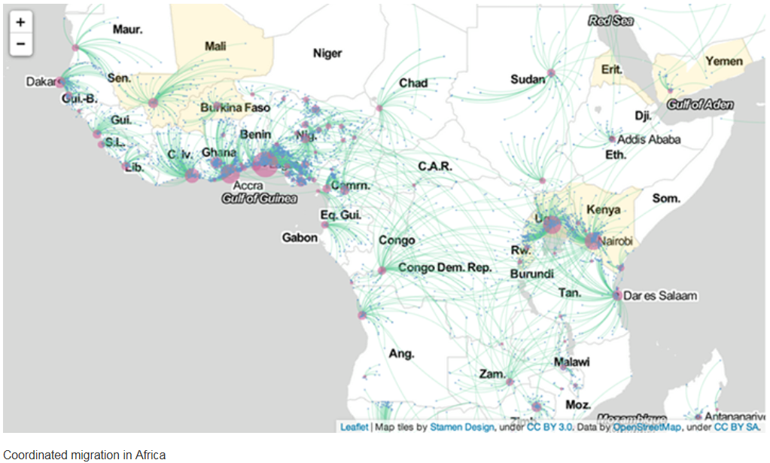
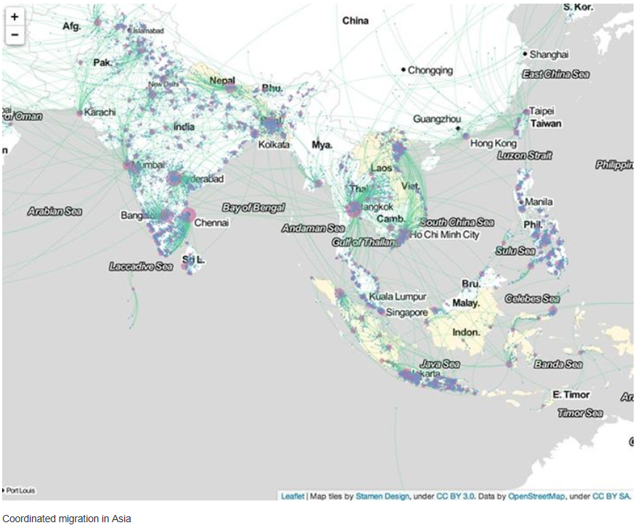
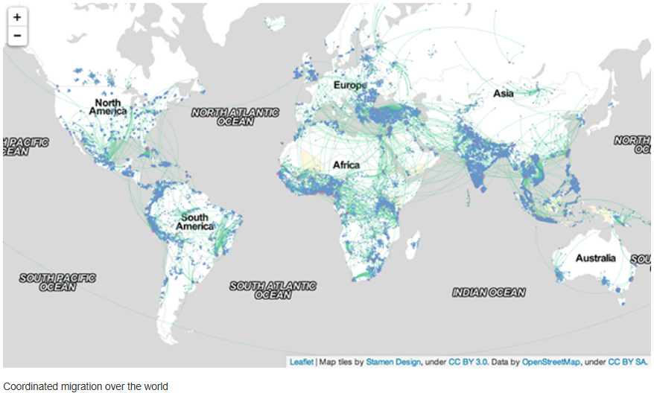
Migrations and social media
Aude H.et al. (2013). Coordinated Migration. Facebook Data Science Team. December 17, 2013

Slide 20
Big data and financial transfers
Financial data (banks, postal offices, etc.): analysis of remittance flows
Credit card transaction and analysis of residents and foreign visitors in Spain (Sobolevsky et al., 2014)
Mobile money transfers: e.g., M-PESA in Kenya (Hughes and Lonie, 2007) since 2007, now 15 million users and processes 2 million transactions per day in a country of 25 million adults) and now available in 70+ countries, and modalities and determinants of mobile money transfers in the aftermath of natural disasters in Rwanda (Blumenstock et al., 2013)
Question about cross-border financial flows: how do we know that the financial flows are transmitted by migrants?

Slide 21
Big data and administrative data sources
Where do administrative data sources end and do big data start?
For instance, in the context of immigration, tons of data is collected (visa applications, etc.).
It would be very interesting to analyse (anonymized) immigration records from the immigration authorities in terms of characteristics of the applicant, the approved person, origin, destination, duration, age, sex, etc.

Slide 22
Big data and fighting criminal migration-related activities
Human trafficking:
How Big Data Battles Human Trafficking: From services for victims to prosecuting offenders, new technologies are being utilized to address exploitation. U.S. News. Jan. 14, 2015
Command, Control and Interoperability Center for Advanced Data Analysis at Rutgers University: CCICADA’s Proprietary Algorithms Sort through Millions of Bits of Online Data, Sniffing Internet Ads for Clues, May 9, 2014
Microsoft Research Faculty 2012 Summit: panel on the Role of Technology in Human Trafficking [slides]
USC Center on Communication Leadership & Policy (2011). Human Trafficking Online: The Role of Social Networking Sites and Online Classifieds - http://technologyandtrafficking.usc.edu/report/
Migrant smuggling:
In the context of the European migrant crisis in the Mediterranean, see references to fight migrant smuggling by taking down websites used by smugglers

Slide 23
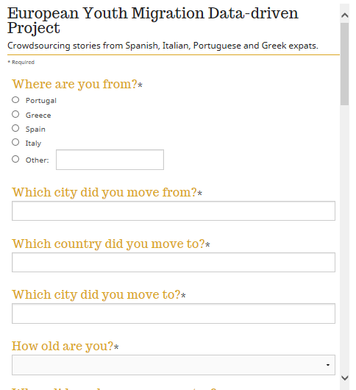
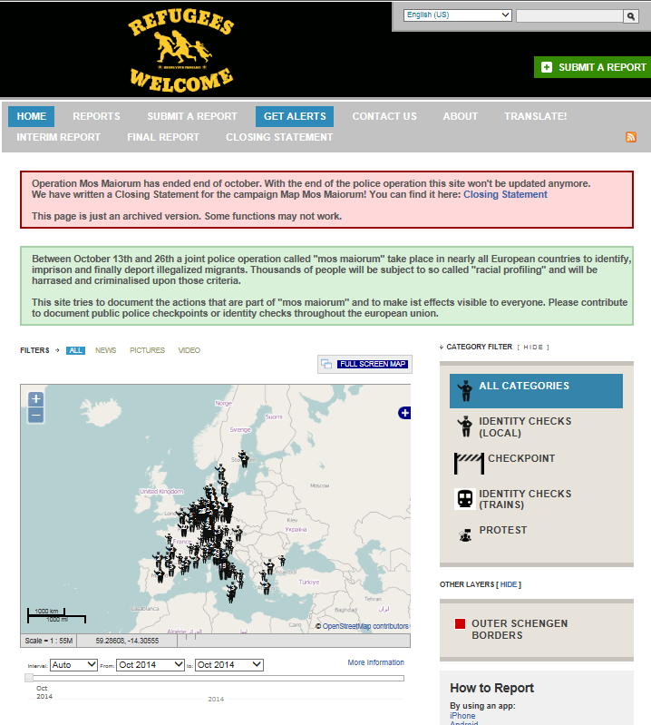
Crowdsourcing and migrations
Crowdsourcing youth migration from southern Europe to the UK: first pan-European data driven investigation on the issue of young migrants. TheGuardian.com, Ottaviani Data Blog. 2 October 2014.
Crowdsourced map helps migrants evade European crackdown: "Mos Maiorum" operation checkpoints tracked online. Aljazeera.com, October 14, 2014 - http://map.nadir.org/ushahidi/

Slide 24
Major mobility issues
International tourisms/visitors/travel
Internal migrations
IDPs and humanitarian crises/ forced displacements
City management, commuting patterns, transport network, traffic flows, mass transit and infrastructure planning and management
Seasonal migrations

Slide 25
Big data and humanitarian emergencies
Potential (or lack thereof) of 'big data' in humanitarian emergencies.
Exact definition of a migrant is here not an issue.
Real issue becomes displacement / relocation regardless of the duration of stay.

Slide 26
Mobility and Call Detail Records (CDR) from mobile phones
Track post-disaster displacement: Haiti (Bengtsson et al., 2011), New Zealand (ACAPS, 2013), Mexico (Moumni, 2013)
daily mobility to monitor the diffusion of epAnalyze idemics and effectiveness of various public health measures to reduce person-to-person contacts in case of pandemic (e.g., swine flu, H1N1, ebola) – (e.g., Frias-Martinez, 2012; Flowminder Foundation West Africa human mobility models)
Internal and circular migrations: Rwanda (Blumenstock, 2012), urban-rural (Eagle et al. 2009; Yadav et al. 2013), impact of socioeconomic status on migration in one Latin American city (Frias-Martinez et al. 2010), predictability of human mobility (Lu et al. 2012; Lu et al. 2013)

Slide 27
Dynamic population mapping using mobile phone data
Deville et al. (2014). Dynamic population mapping using mobile phone data. Proceedings of the National Academy of Sciences, 111(45), 15888-15893. doi: 10.1073/pnas.1408439111

Slide 28
Dynamic population mapping using mobile phone data
Deville et al. (2014). Dynamic population mapping using mobile phone data. Proceedings of the National Academy of Sciences, 111(45), 15888-15893. doi: 10.1073/pnas.1408439111

Slide 29
Mobile phone usage patterns and type of human activities
Grauwin, S., Sobolevsky, S., Moritz, S., Gódor, I., & Ratti, C. (2015). Towards a Comparative Science of Cities: Using Mobile Traffic Records in New York, London, and Hong Kong. Computational Approaches for Urban Environments (pp. 363-387): Springer.

Slide 30
Location of urban hotspots using mobile phone data
Louail et al (2014). From mobile phone data to the spatial structure of cities. Sci. Rep., 4. doi: 10.1038/srep05276

Slide 31
Mobility and social media
Analyze communication patterns related to natural events and to man-made events relevant for monitoring of real-time migration flows (Neubauer, 2015) in daily number of geo-referenced Tweets in three Ukraine regions and Japan from Aug.-Oct. 2014 and in Egypt (Neubauer, 2014)
Analyze global patterns of human mobility based on almost a billion tweets in 2012, and estimate international travels by country of residence (Hawelka et al. 2014) and within and between cities in Australia using six million geotagged tweets (Jurdak et al. 2014)

Slide 32
Mobility and social media
Hawelka, B., Sitko, I., Beinat, E., Sobolevsky, S., Kazakopoulos, P., & Ratti, C. (2014). Geo-located Twitter as proxy for global mobility patterns. Cartography and Geographic Information Science, 41(3), 260-271.

Slide 33
Mobility and social media
Hawelka, B., Sitko, I., Beinat, E., Sobolevsky, S., Kazakopoulos, P., & Ratti, C. (2014). Geo-located Twitter as proxy for global mobility patterns. Cartography and Geographic Information Science, 41(3), 260-271.

Slide 34
Mobility and social media
Hawelka, B., Sitko, I., Beinat, E., Sobolevsky, S., Kazakopoulos, P., & Ratti, C. (2014). Geo-located Twitter as proxy for global mobility patterns. Cartography and Geographic Information Science, 41(3), 260-271.

Slide 35
Potential strength of big data
Frequent and potential in real time or with short lag
No cost or low cost
Often geolocated
Usually with time stamp
Potential / optional unique stable ID for matching / linking
Potentially invaluable insights for longitudinal follow-up (including geolocation)
Social interactions: ego-centric ties and full network
Might allow to know more or collect info about life history and vital events
Any individual attributes linkable?

Slide 36
Concerns/pending issues
What kind of big data?
For what purpose?
Who has access to what kind of information?
Coverage/representativity and selection bias issues (i.e., who is not counted)
Potential issues with multiple counts
Validation of results
Issue of comparability of information across space and time
Transparency, accountability and replication
Individual rights, privacy and confidentiality

